Slide 1
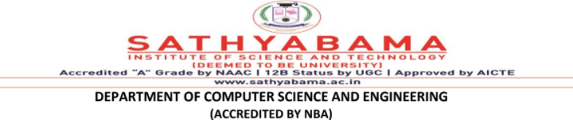
Course Name:
COMPILER DESIGN LAB
Course code:
SCSA2602

Slide 2
Course Objectives
Deepen the understanding of compiler design.
To enrich the knowledge in various phases of compiler and its use, code optimization techniques, machine code generation, and use of symbol table.
To extend the knowledge of parser by parsing LL parser and LR parser.
To provide practical programming skills necessary for constructing a compiler.
To implement NFA and DFA from a given regular expression.

Slide 3
List of Experiments
Implement Token Separation for a given expression using LEX.
Use LEX tool to implement Lexical Analyzer.
Use LEX and YACC to implement parser.
Use LEX and YACC tool to implement Desktop Calculator.
Construction of NFA from a regular expression.
Construction of DFA from a regular expression.
Implement Recursive Descent Parser algorithm.
Implement Shift Reduce Parser algorithm.
Implement the frontend of the compiler to produce three address code.
Implement Symbol Table management
Construct a simple compiler.

Slide 4
Flex (Fast Lexical Analyzer Generator )
A tool/computer program for generating lexical analyzers (scanners or lexers) written by Vern Paxson in C around 1987.
It is used together with Berkeley Yacc parser generator or GNU Bison parser generator.
Flex and Bison both are more flexible than Lex and Yacc and produces faster code.
YACC-Yet Another Compiler Compiler

Slide 5
LEX-LEXICAL ANALYZER GENERATOR
Lex is a lexical analyzer tool mostly used with yacc parse generator.
Tool for recognizing tokens in a program.
Tokens are the terminals of a language,
English:
words, punctuation marks, …
Programming language:
Identifiers, operators, keywords, …
Regular expressions define terminals/tokens.
It lexically analyses (i.e. matches) the patterns (regular expressions) given as input string or as a file.

Slide 6
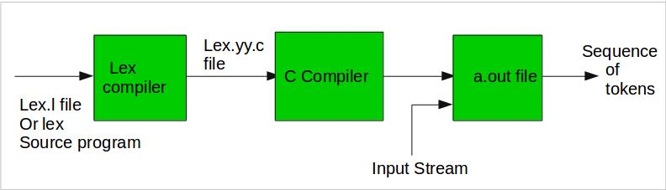
Processing a LEX program
Step 1: An input file describes the lexical analyzer to be generated named lex.l is written in lex language. The lex compiler transforms lex.l to C program, in a file that is always named lex.yy.c.
Step 2: The C complier compile lex.yy.c file into an executable file called a.out.
Step 3: The output file a.out take a stream of input characters and produce a stream of tokens.

Slide 7
Structure of LEX Program
The lex program consists of three sections, separated by a line with just %% ;
definitions section
%%
rules section
%%
auxiliary function/user code section

Slide 8
Lex predefined functions and variables
yyin | the input stream pointer.
yytext | a buffer that holds the input characters that actually match the pattern (i.e lexeme).
yyleng | the length of the lexeme .
yylval | contains the token value .
yyout | the output stream pointer.
yylex() | The main entry point for lex, reads the input stream generates tokens, returns zero at the end of input stream.
yywrap() | Called by lex when input is exhausted (or at EOF). default yywrap always return 1.
yymore() | returns the next token .
yyless(k) | returns the first k characters in yytext .

Slide 9
Definition Section
generally used to declare functions, include header files, or define global variables and constants .
text is enclosed in %{ … %} brackets. Anything written in this brackets is copied directly to the file lex.yy.c
eg.:
%{
#include<stdio.h>
int global_variable;
}%
Regular definitions, has of the form,
name definition
e.g.:
digit [0-9]
letter [a-zA-Z]

Slide 10
Rules Section
Each rule has the form
pattern action
where:
pattern describes a pattern to be matched on the input.
action must begin on the same line.
If action is empty, the matched token is discarded.
eg.:
%%
{digit}+ {printf(“ number”);}
{letter}* {printf(“ name”);
%%

Slide 11
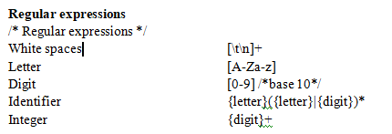
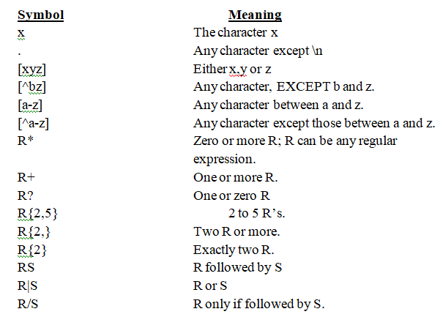
How to write rules

Slide 12
Auxiliary Functions
LEX generates C code for the rules specified in the Rules section and places this code into a single function called yylex().
/* Declarations */
%%
/* Rules */
%%
int main()
{
yylex();
return 1;
}
This section contain C statements and additional functions.

Slide 13
Executing a Lex Program
Lex source program
Lex
lex.yy.c
lex.yy.c
C compiler
a.out
Input file
a.out
Stream of tokens

Slide 14
How to run the program
run the program, it should be first saved with the extension .l or .lex.
Step 1: lex filename.l or lex filename.lex
Step 2: gcc lex.yy.c
Step 3: ./a.out
Step 4: Provide the input to program in case it is required
https://flex-windows-lex-and-yacc.software.informer.com/

Slide 15
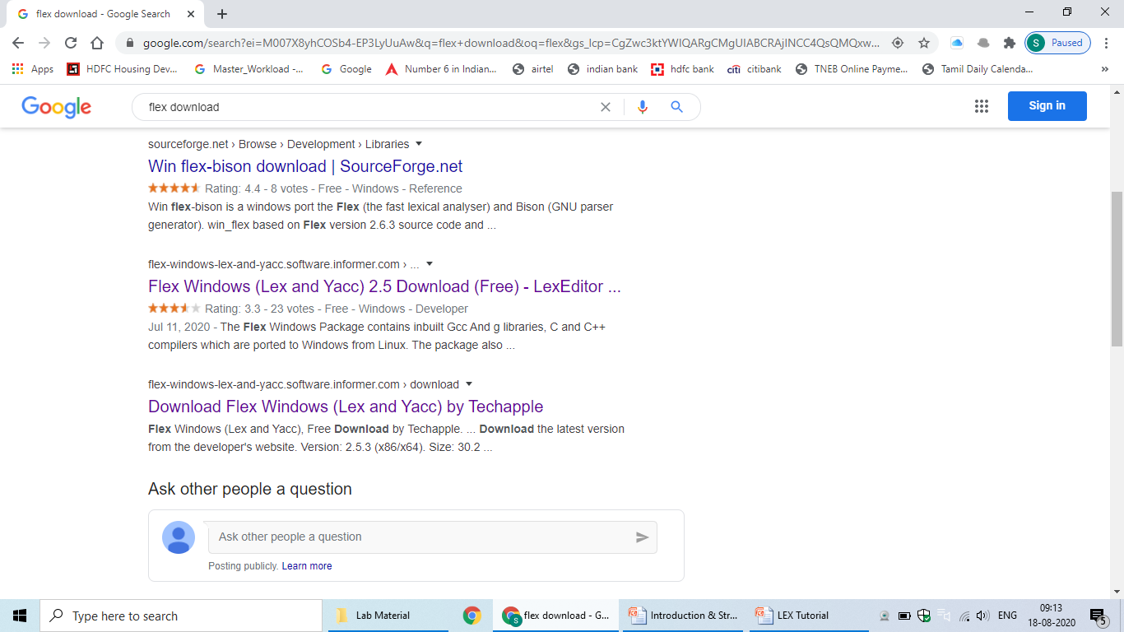


Slide 16
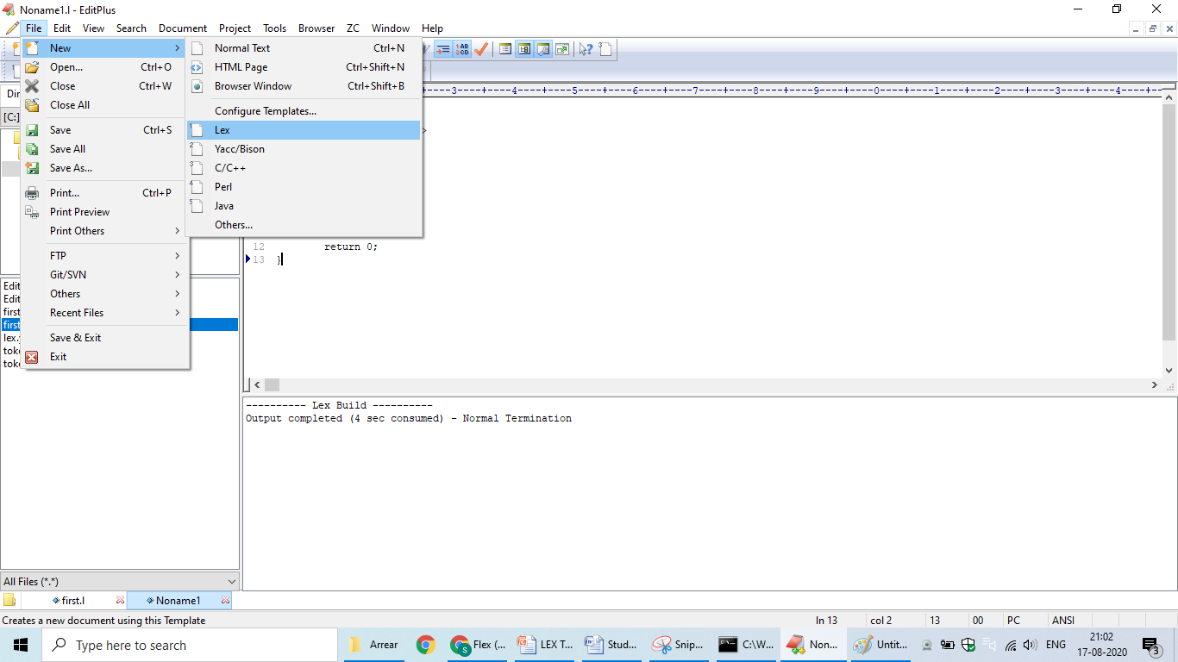

Slide 17
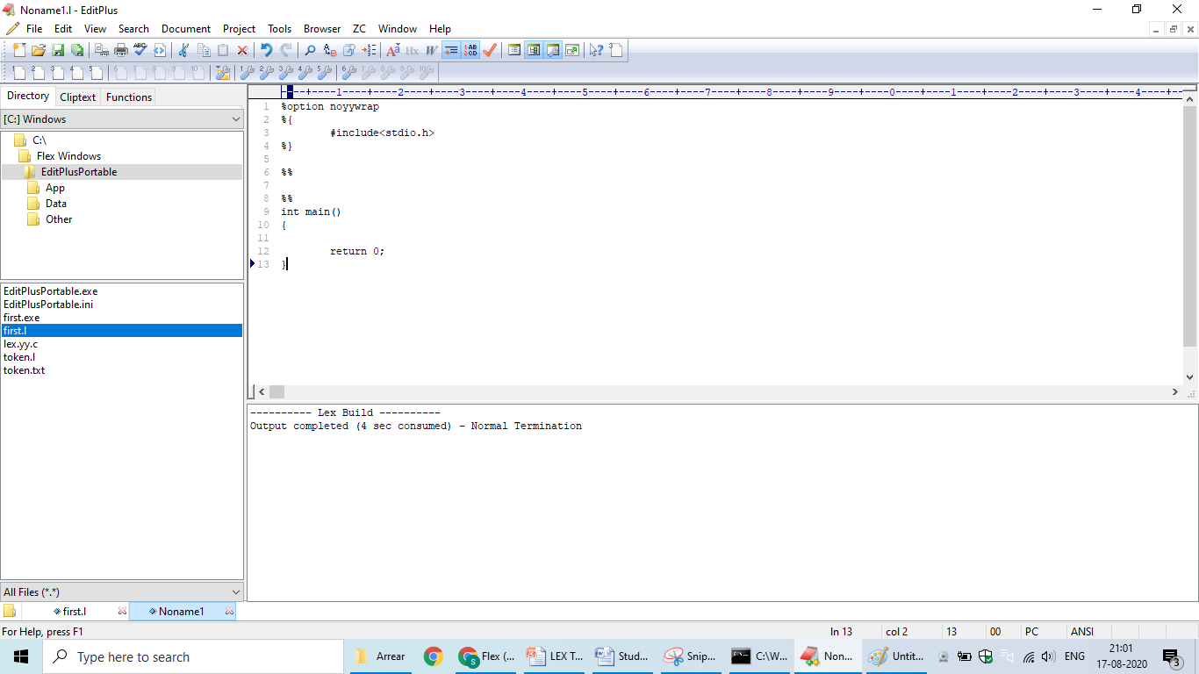

Slide 18
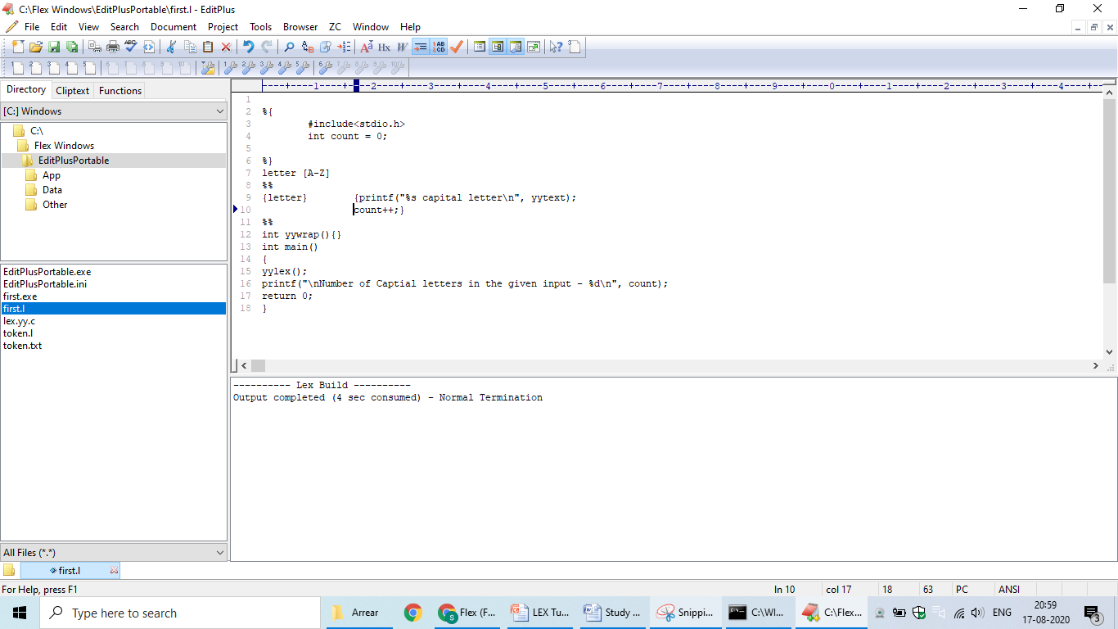

Slide 19
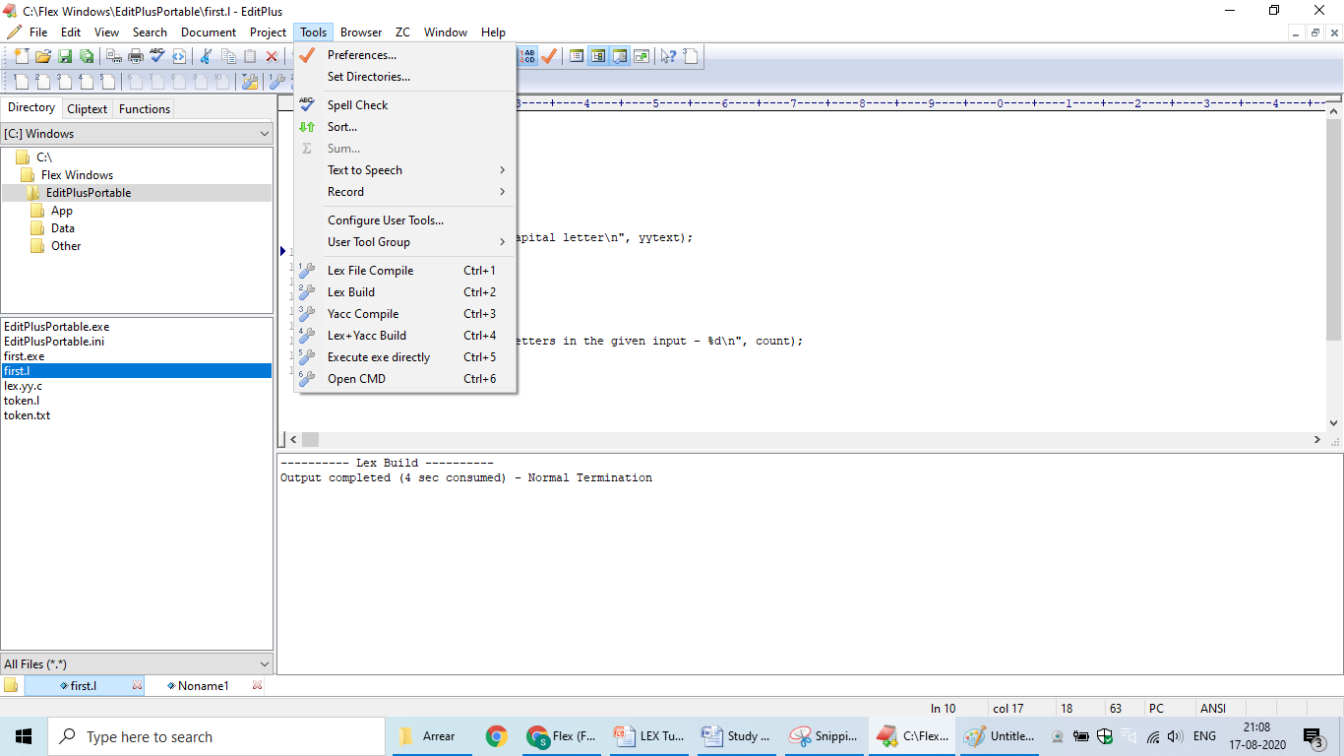

Slide 20
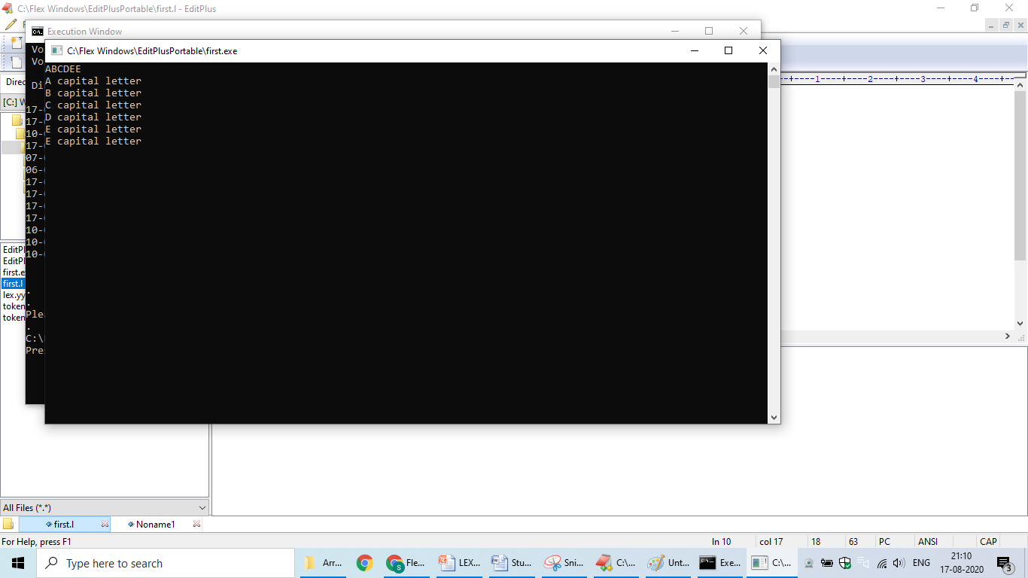

Slide 21
JFLAP
JFLAP (Java Formal Languages and Automata Package) is interactive educational software written in Java for experimenting with topics in the computer science area of formal languages and automata theory.
JFLAP is developed and maintained at Duke University, with support from the National Science Foundation since 1993.
It is freeware , runs as a Java application.

Slide 22
What is JFLAP?
Learning about automata with pen and paper can be difficult, time consuming and error-prone.
To create and simulate structures,
a finite state machine, and experiment with proofs,
converting a nondeterministic finite automaton (NFA) to a deterministic finite automaton (DFA).
supports creation of DFA and NFA, Regular Expressions, PDA, Turing Machines, Grammars and more.
https://www.softpedia.com/get/Others/Home-Education/JFLAP.shtml

Slide 23
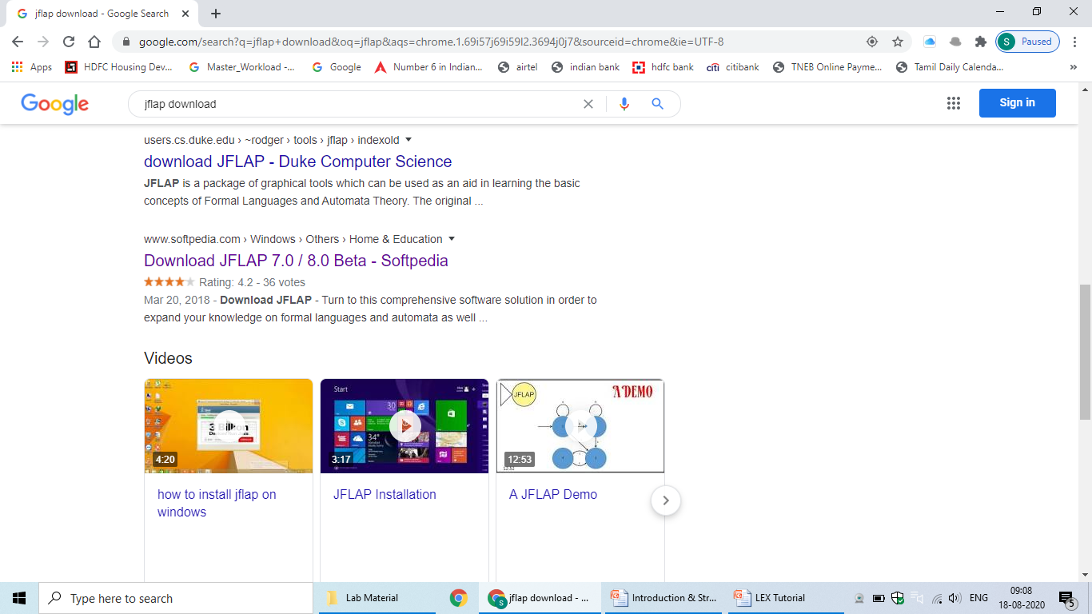



Slide 24
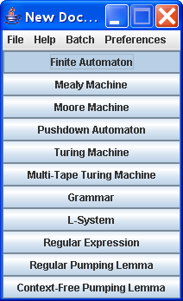
To start a new FA, start JFLAP and click the Finite Automaton option from the menu

Slide 25
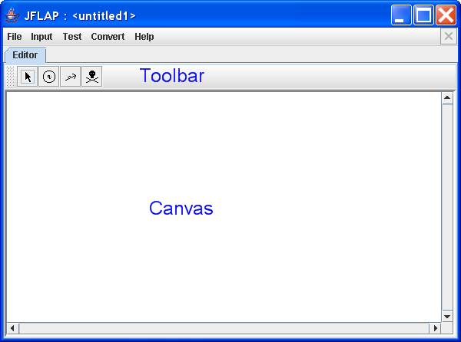

This brings up a new window that allows you to create and edit an FA. The editor is divided into two basic areas:
The canvas, which you can construct your automaton on, and
The toolbar, which holds the tools you need to construct your automaton.

Slide 26
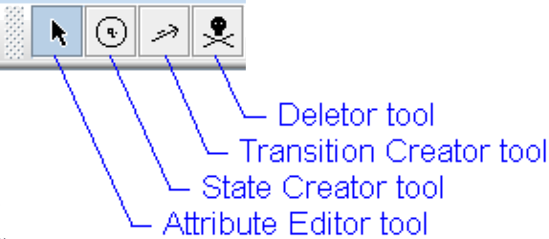
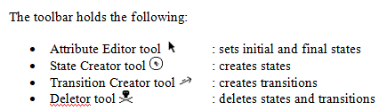

Slide 27
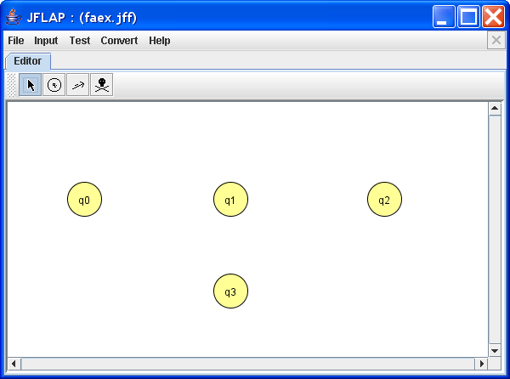
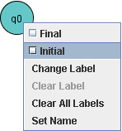
Creating States
Set initial and final state

Slide 28


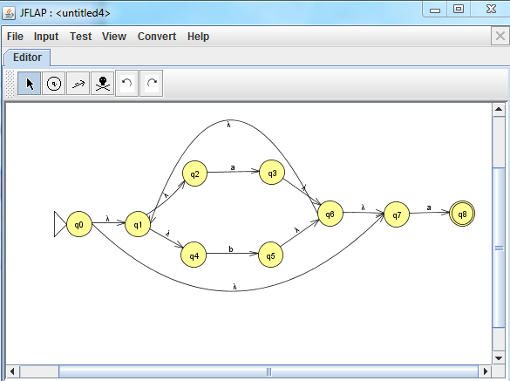
Creating Self Transition
Transition between states
NFA for (a|b)*a

Slide 29
THANK YOU

